Slide 1
Updated Chapter 3: Does temporal occupancy improve classic SDMs for birds in North America?

Slide 2
Question
Does temporal occupancy predict avian species distribution models better than presence/absence?

Slide 3

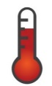



Data
196 focal species
Occurred at >40 BBS routes during 15 years
>= 50 presences across the range
953 BBS routes surveyed consecutively
2001-2015
5 Bioclim variables
Temperature Seasonality (standard deviation *100)
Max Temperature of Warmest Month
Min Temperature of Coldest Month
Precipitation of Wettest Month
Precipitation of Driest Month
Elevation
NDVI
Thuiller et al. 2014, Bahn and McGill 2007

Slide 4
Data
196 focal species
Occurred at >40 BBS routes during 15 years
>= 50 presences across the range
953 BBS routes surveyed consecutively
2001-2015
5 Bioclim variables
Temperature Seasonality (standard deviation *100)
Max Temperature of Warmest Month
Min Temperature of Coldest Month
Precipitation of Wettest Month
Precipitation of Driest Month
Elevation
NDVI
Thuiller et al. 2014, Bahn and McGill 2007

Slide 5
Methods
4 SDM methods tested using temporal occupancy and presence/absence, including/excluding transient species
GLM
GAM
Random Forest
MaxEnt
Model evaluation: root mean square error (RMSE)
http://climate.audubon.org
Notes:
root-mean-square error (RMSE) (or sometimes root-mean-squared error) is a frequently used measure of the differences between values (sample or population values) predicted by a model or an estimator and the values observed. The RMSD represents the square root of the second sample moment of the differences between predicted values and observed values or the quadratic mean of these differences. These deviations are called residuals when the calculations are performed over the data sample that was used for estimation and are called errors (or prediction errors) when computed out-of-sample. The RMSD serves to aggregate the magnitudes of the errors in predictions for various times into a single measure of predictive power. RMSD is a measure of accuracy, to compare forecasting errors of different models for a particular dataset and not between datasets, as it is scale-dependent.^{[1]}
RMSD is always non-negative, and a value of 0 (almost never achieved in practice) would indicate a perfect fit to the data. In general, a lower RMSD is better than a higher one.
http://climate.audubon.org/sites/default/files/NAS_EXTBIRD_V1.3_9.2.15%20lb.pdf

Slide 6
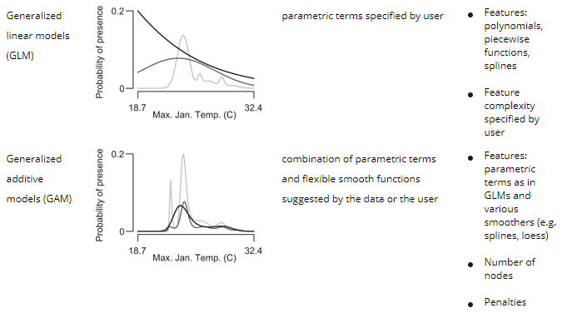
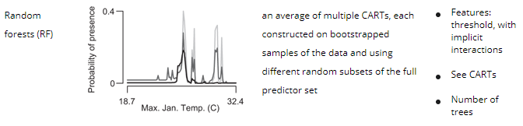
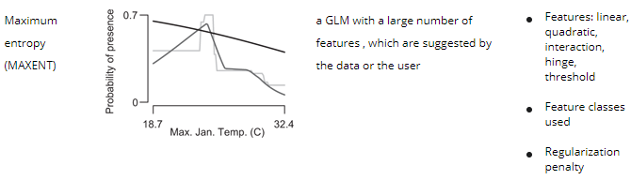
Notes:
Algorithm Response curves Responses are built from Complexity controlled by

Slide 7
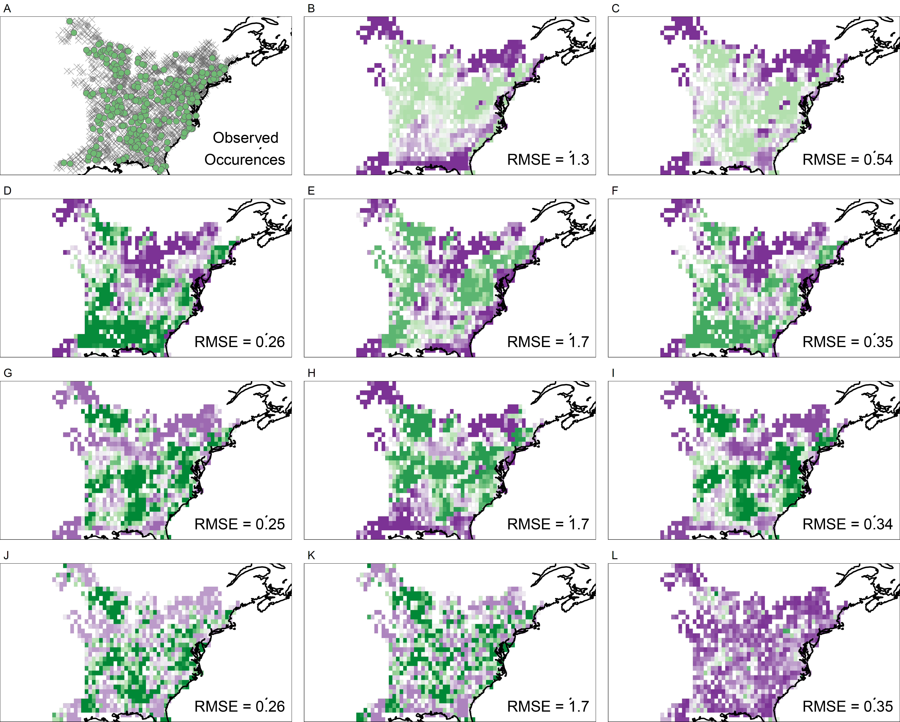
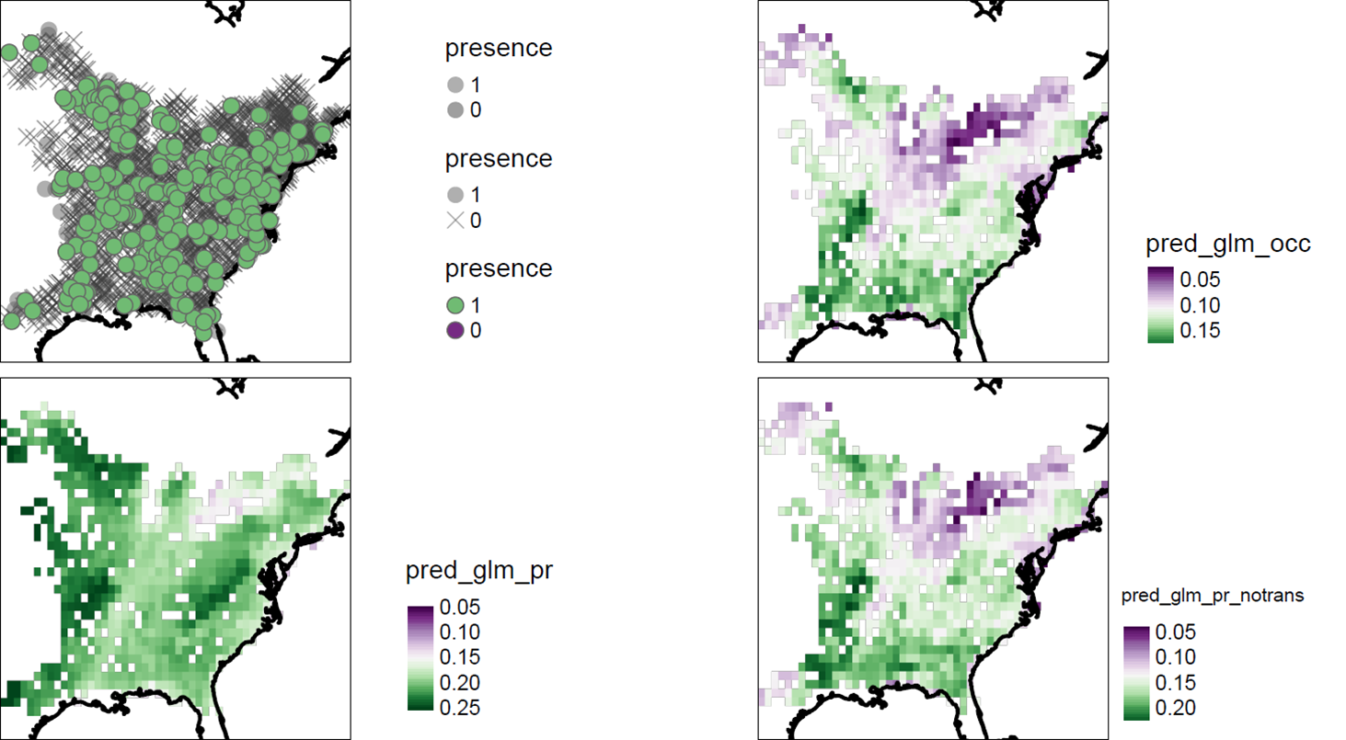
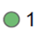

MaxEnt
5+ presences
Suitability
GLM
High
Low
GAM
RF
Temporal Occupancy
Presence/Absence
>33% Presence

Slide 8
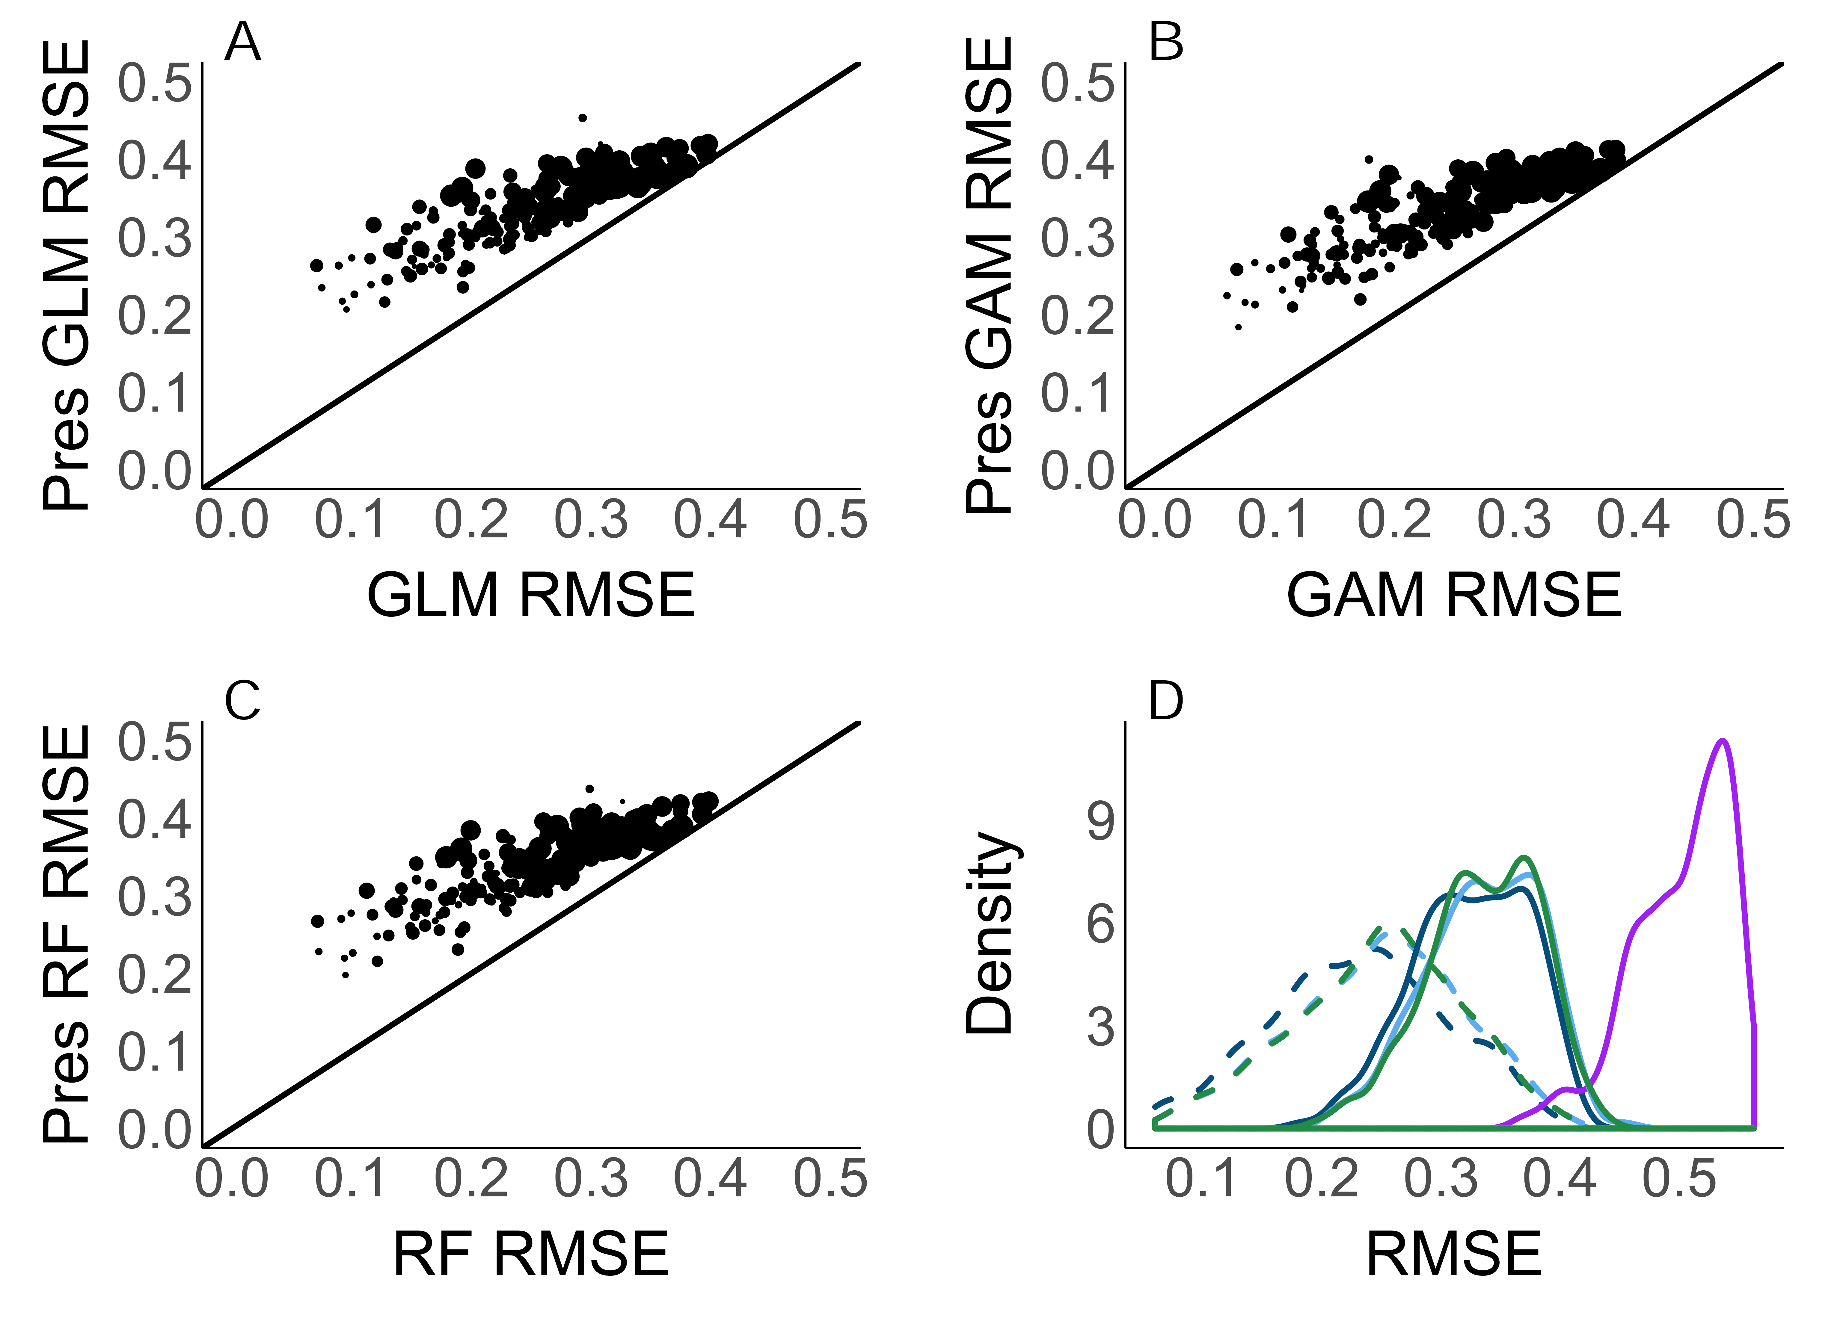
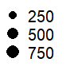
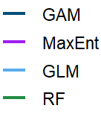
RMSE output: 196 focal species
Notes:
Thuiller 2014 vars, 196 focal spp
Pres always higher bc higher RMSE is worse
Same general results with 17 bioclim vars (subset of 83 focals)
Points sized by number of stateroutes spp occurs at, each points is a spp

Slide 9
RMSE presence: presence excluding transients
Notes:
Presence including transients rmse always higher except for MaxEnt

Slide 10
Next Steps
Improvements to methods
Additional analyses
Manuscript in progress
goal submission by December 2019
Target journals: Ecography, Diversity & Distributions
Additional comments/concerns?

Slide 11
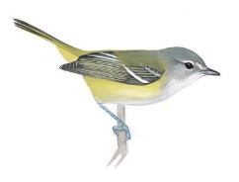
GLM | GAM | RF | MaxEnt
High suitability
Occupancy
Occupancy
Occupancy
Low suitability
Yellow-throated Vireo
Presence
Presence
Presence
Presence
Notes:
Probably need to put these all on the same scale
YTVI, 6280

Slide 12
GLM | GAM | RF | MaxEnt
High suitability
Occupancy
Occupancy
Occupancy
Low suitability
Yellow-throated Vireo
Presence
Presence
Presence
Presence
Notes:
Probably need to put these all on the same scale
YTVI, 6280

Slide 13
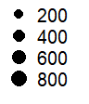
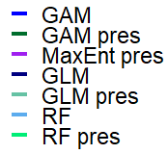
RMSE excluding transients: 108 focal species

